Slide 1
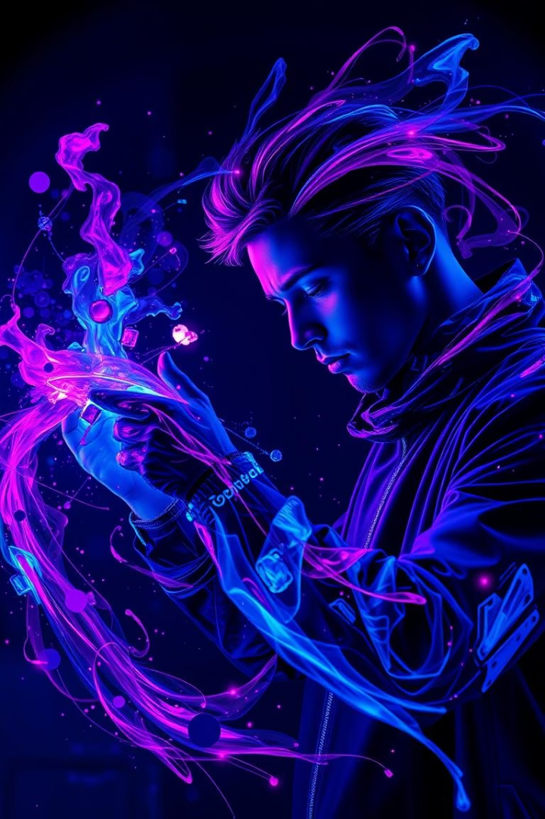
Title: Air Drawing App using Computer Vision
Subtitle: Statement Code: CV-06
Compiler : Jupiter note book.
Tools Used: Python, OpenCV, NumPy

Slide 2

The Problem: Limited Digital Creation
Not Accessible for All
No Access to Input Devices
Need for Touch-Free Interfaces
People with motor issues struggle with traditional input methods. Solution: Enables drawing through simple hand gestures.
Many users lack tools like stylus or touchscreens for digital drawing. Solution: Draw using just a webcam and a colored object.
Touch-based tools can spread germs in shared spaces. Solution: Offers safe, contactless drawing interaction.

Slide 3

Tools & Technologies
Python
OpenCV
NumPy
Webcam / Laptop Camera
Jupiter Notebook

Slide 4





Work Behind Air Drawing app
Detect colored object (e.g., Blue pen cap)
Track its movement using contours
Draw a line between previous and current positions
Show live drawing on screen

Slide 5
Work Behind Air Drawing app
1.Introduction & Objective
Virtual Paint Using Color Detection
The program uses a webcam and OpenCV to track a colored object in real-time.
The object acts like a brush to draw on a virtual canvas.
It supports multiple colors: Blue, Green, Red, and Yellow.
You can also switch colors or clear the canvas using on-screen buttons.
2.Setting Up the Interface
Trackbars & Canvas Setup
cv2.createTrackbar() creates sliders to set HSV (Hue, Saturation, Value) color range for object detection.
paintWindow: A white canvas where drawing happens.
Colored rectangles at the top of the screen act as buttons (Clear, Blue, Green, Red, Yellow).
Text labels are added using cv2.putText().

Slide 6
Work Behind Air Drawing app
3. Capturing and Processing Video
Frame Processing & Color Detection
cap = cv2.VideoCapture(0) opens the webcam.
Each frame is flipped (cv2.flip()) and converted to HSV (cv2.cvtColor()).
The HSV range from trackbars is used to generate a mask of the detected color (cv2.inRange()).
Morphological operations clean the mask: erode, open, and dilate.
4. Detecting the Marker and Handling Buttons
Contour Detection & User Interaction
Contours in the mask are found using cv2.findContours().
The largest contour is considered the marker.
If marker is near the top (y ≤ 65), it checks for button press:
Clear: resets all points.
Color buttons: changes brush color.
Else, marker coordinates are stored for drawing.

Slide 7
Work Behind Air Drawing app
5. Drawing Mechanism & Output
Drawing on Frame and Canvas
Points are stored in deques based on color (Blue, Green, Red, Yellow).
cv2.line() draws connecting lines between points.
Drawing happens on both:
The live video feed (frame).
The persistent white canvas (paintWindow).
cv2.imshow() displays:
Live tracking,
The canvas,
The binary mask.
Pressing ‘q’ quits the program.

Slide 8

Core Code Snippet – Color Detection
hsv = cv2.cvtColor(frame, cv2.COLOR_BGR2HSV)
mask = cv2.inRange(hsv, lower_red, upper_red)
contours, _ = cv2.findContours(mask, cv2.RETR_EXTERNAL, cv2.CHAIN_APPROX_SIMPLE)

Slide 9
Running the Air Drawing App – Main Loop & Exit Handling
Starting video capture
cap = cv2.VideoCapture(0)
Main loop
while True: success, frame = cap.read() if not success: break
# Flip the frame (mirror effect) frame = cv2.flip(frame, 1) # Your processing logic goes here # (e.g., color detection, drawing, gesture recognition) cv2.imshow("Air Drawing App", frame) # Exit condition: Press 'q' to quit if cv2.waitKey(1) & 0xFF == ord('q'): break
Releasing resources
cap.release() cv2.destroyAllWindows()

Slide 10
Core Code Snippet – Drawing Logic
if contours:
x, y, w, h = cv2.boundingRect(contours[0])
if prev_x and prev_y:
cv2.line(canvas, (prev_x, prev_y), (x, y), (0, 0, 255), 5) prev_x, prev_y = x, y

Slide 11
Features
Real-time drawing: The app captures movements instantly, allowing users to draw live on-screen with minimal delay or lag.
Color-based tracking: It identifies and follows specific colored object, using HSV values to isolate and track the "pen."
No external hardware: Only a webcam is required; the system works without needing styluses, sensors, or additional devices.
Smooth and responsive: Efficient contour detection and frame processing ensure fluid drawing actions and immediate system response to movement.
Applications
Kids’ Drawing Tool: Provides an engaging and mess-free way for children to express creativity by drawing virtually with a color-tracked pen.
Touch-Free UI for Public Kiosks: Enables hands-free interactions at public kiosks, reducing physical contact and enhancing hygiene in high-traffic areas.
Motor-Impaired Assistance: Offers an accessible alternative for individuals with motor impairments, allowing them to create digital drawings with minimal physical effort.
Fun Interactive Learning: Enhances learning by integrating engaging visual activities, making educational experiences more enjoyable through digital interaction.

Slide 12
Thank You

